Slide 1
Computer Vision
Data augmentation & vidéo analysis

Slide 2
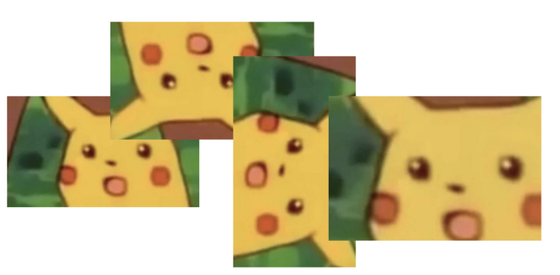
Plan
Data augmentation
Overview
Deep learning
GANs
Video analysis
Action classification
Object tracking

Slide 3
Data augmentation
Reals vs synthetics

Slide 4

Overview
The idea: to create a larger (synthetic) dataset that will better generalize to the situations that the model may encounter in production.
Techniques:
Traditional: cropping, rotating, flipping, brightness, kernel filters…
Negative data augmentation
Deep learning: GANs
Cannot create new items.
Is flipping images interesting for a self driving car project ?
Don’t put them in testing set !
Your CV might be off.
Conclusion:
Seems efficient only when dataset is very small.
Notes:
https://blog.roboflow.com/boosting-image-detection-performance-with-data-augmentation/
https://journalofbigdata.springeropen.com/articles/10.1186/s40537-019-0197-0

Slide 5
Deep learning
Label
Image
Generator
Classifier
CNN A
CNN B
Image
Image
Label
Loss score
Image

Slide 6
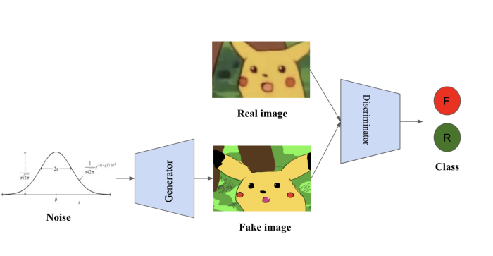
GANs
Communication
CNN
CNN
Notes:
https://blog.roboflow.com/boosting-image-detection-performance-with-data-augmentation/
https://medium.com/@dc.aihub/data-augmentation-for-neural-networks-and-computer-vision-b4f993c34e91
https://machinelearningmastery.com/what-are-generative-adversarial-networks-gans/

Slide 7
Video analysis
Classification & Tracking

Slide 8
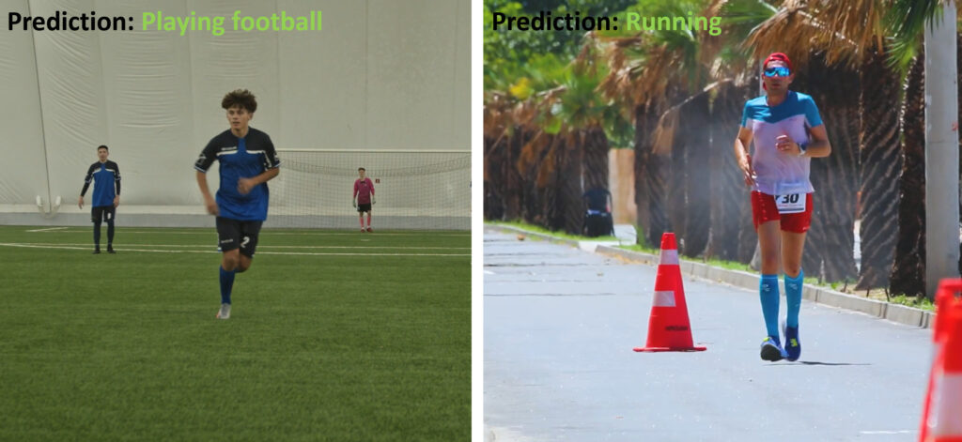
Action classification
Similar activity / very different context = normal image classification problem
Notes:
https://learnopencv.com/introduction-to-video-classification-and-human-activity-recognition/

Slide 9
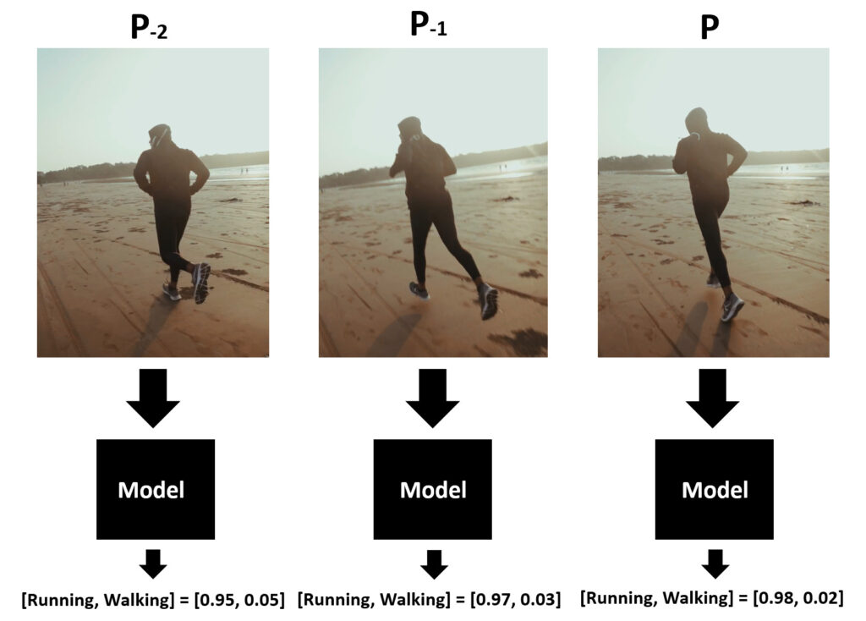
Action classification
Similar activity / no context = normal image classification problem with frame probability
Notes:
https://learnopencv.com/introduction-to-video-classification-and-human-activity-recognition/

Slide 10
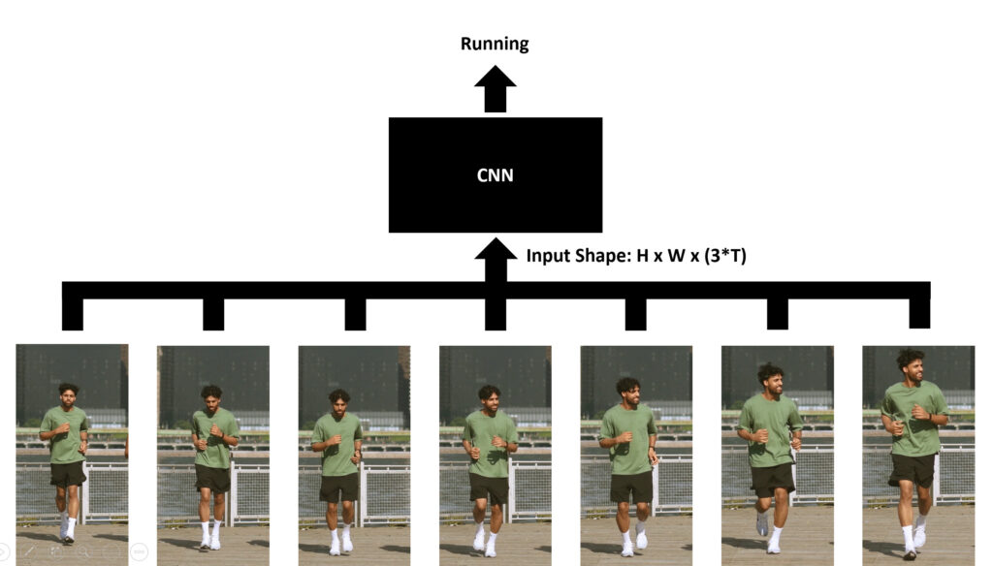
Action classification
What to do in case of temporal difference ?
Early fusion CNN
Notes:
https://learnopencv.com/introduction-to-video-classification-and-human-activity-recognition/

Slide 11
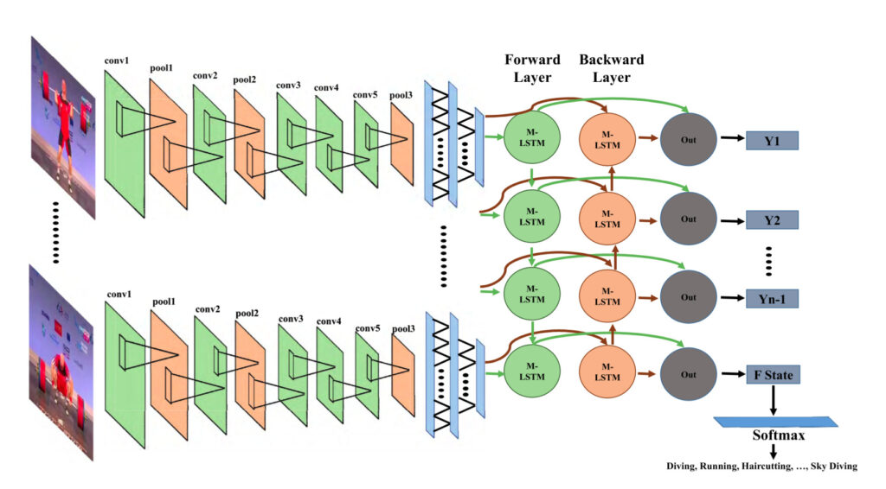
Action classification
What to do in case of temporal difference ?
CNN + LSTM
Notes:
https://learnopencv.com/introduction-to-video-classification-and-human-activity-recognition/

Slide 12
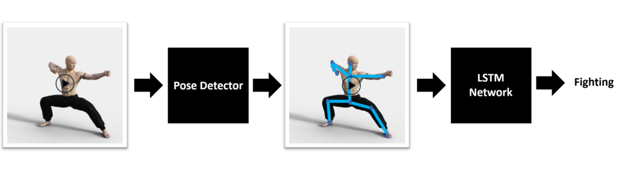
Action classification
What to do in case of temporal difference ?
Pose detector (CNN) + LSTM
Notes:
https://learnopencv.com/introduction-to-video-classification-and-human-activity-recognition/

Slide 13
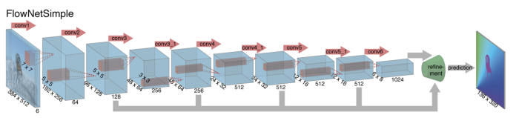
Object tracking
Detection:
With (based)
Without (free)
Number:
Single
Multiple
Tracking:
Online
Offline
Learning:
Online
Offline
FlowNet
output the optical flow from two frames
Offline learning
Single object
Detection free
Notes:
https://cv-tricks.com/object-tracking/quick-guide-mdnet-goturn-rolo/
https://heartbeat.fritz.ai/computer-vision-from-image-to-video-analysis-d1339cf23961

Slide 14
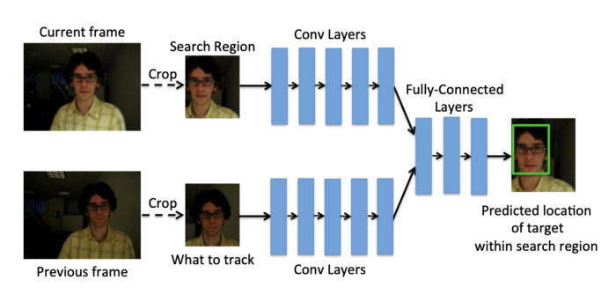
Object tracking
Detection:
With (based)
Without (free)
Number:
Single
Multiple
Tracking:
Online
Offline
Learning:
Online
Offline
GOTURN
Offline learning
Multiple object
Detection free
Notes:
https://cv-tricks.com/object-tracking/quick-guide-mdnet-goturn-rolo/

Slide 15
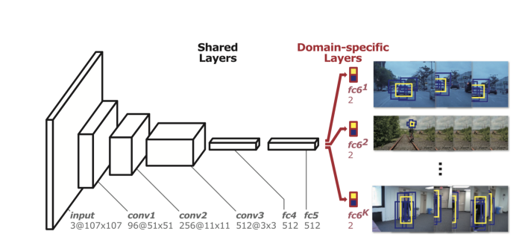
Object tracking
Detection:
With (based)
Without (free)
Number:
Single
Multiple
Tracking:
Online
Offline
Learning:
Online
Offline
MDNet
Online learning
Single object
Detection free
Notes:
https://cv-tricks.com/object-tracking/quick-guide-mdnet-goturn-rolo/

Slide 16
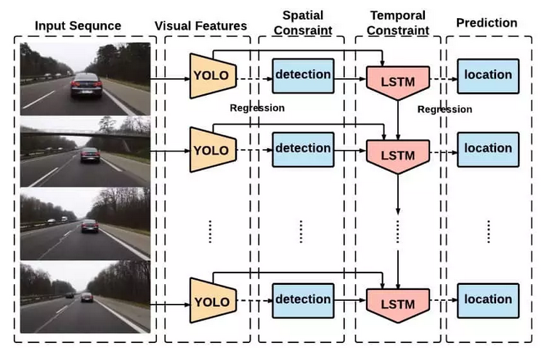
Object tracking
Detection:
With (based)
Without (free)
Number:
Single
Multiple
Tracking:
Online
Offline
Learning:
Online
Offline
ROLO
Online learning
Single object
Detection based
Notes:
https://cv-tricks.com/object-tracking/quick-guide-mdnet-goturn-rolo/

Slide 17
Practice
& questions ?

